Slide 1

Case Study by:
Shubham Shekhaliya
U18CO018

Slide 2

The corporation's current name, Honeywell International Inc., is a product of the merger of Honeywell Inc. and AlliedSignal in 1999.
Honeywell International Inc. is an American publicly listed, multinational, and multi-industry company
It primarily operates in four areas of business:
Honeywell Aerospace
Honeywell Building Technologies
Safety and Productivity Solutions (SPS)
Performance Materials and Technologies (PMT)

Slide 3


Challenge 1
Honeywell Aerospace Helps aircraft mechanics troubleshoot problems with cognitive solutions
Honeywell Aerospace needed a mobile offering to help transform aircraft maintenance by making it faster, connected, and more intelligent. To meet its needs, it sought a new cloud solution.
Honeywell Aerospace implemented the IBM Retrieve and Rank service through the IBM Watson Developer Cloud to improve cognitive computing by using the most relevant information to solve contextual issues.
Specifically, mechanics can utilize this information and share it with each other when performing aircraft maintenance to solve issues some may have not encountered.

Slide 4

Challenge 2
Honeywell’s Process Solutions provides the control systems for a wide range of industrial operations.
the specific characteristics of each system can vary considerably. The processes involved in developing control products involve a high degree of collaboration between Honeywell Process Solutions and its customers.
Honeywell’s Process Solutions was able to completely replicate its internal engineering environment the VMware technology-based Open Virtual Engineering Platform on the IBM Cloud.
With this new environment in place, Honeywell’s Process Solutions customers can now build and test engineering processes in a highly reliable and security-rich cloud-based environment.

Slide 5

Benefits Of IBM Watson
Honeywell Aerospace improved user efficiency when troubleshooting issues
reduced the time needed to solve contextual issues using the knowledge base of the new solution.
improved the quality and the safety of aircraft travel and maintenance
Benefits Of IBM Cloud
Production increased 40%
Cost savings USD 1.3M saved including disaster recovery cost savings, data center cost savings

Slide 6
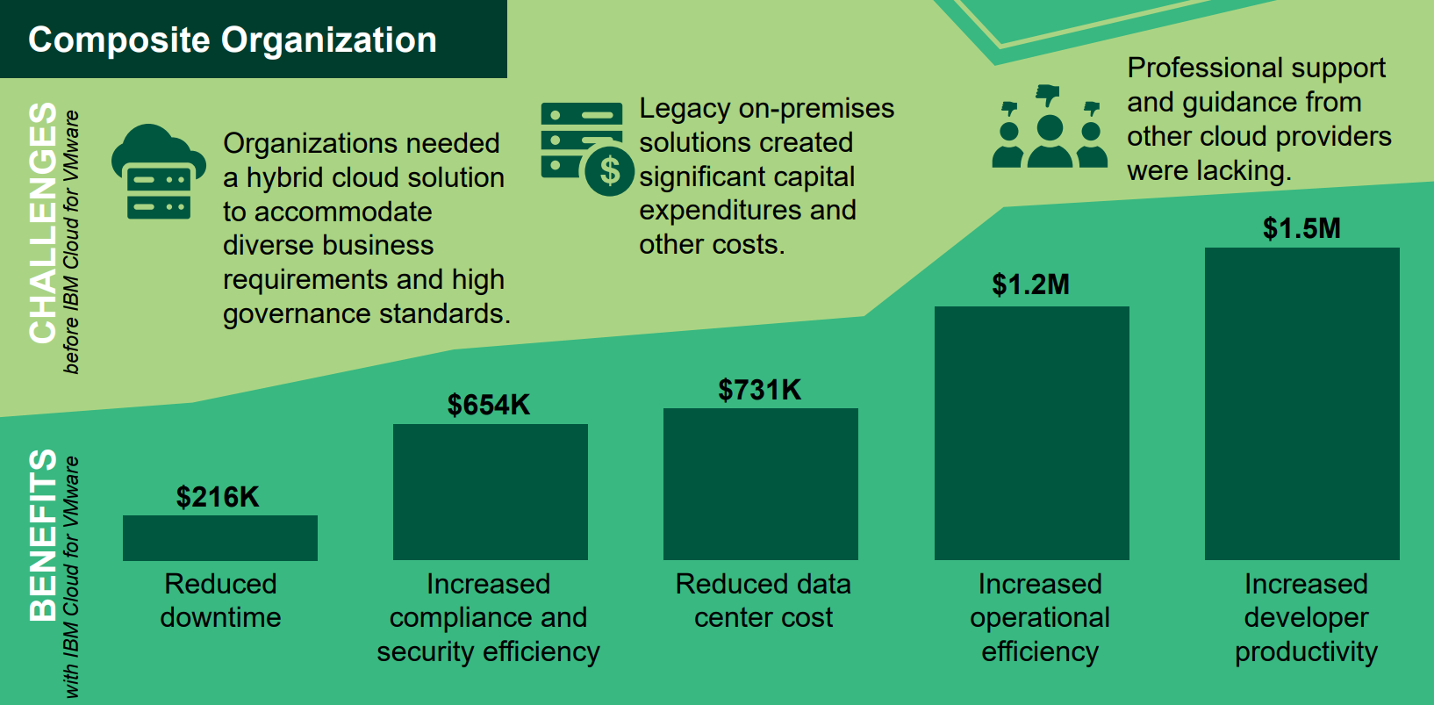
Benefits with IBM Cloud for VMware
The Total Economic Impact Of IBM Cloud for VMware

Slide 7
“Cognitive computing can take the most relevant bits of information in the context of a problem someone has today and generate assistance that they wouldn’t be able to otherwise get.”
— Chad Kartchner, Product Development & Marketing Professional, Honeywell Aerospace
Testimonials
“The IBM Cloud has enabled us to completely replicate our internal engineering environment and provide it to the customer in a direct way that enables them to fulfill their needs in a dedicated fashion.”
— David Selby, Program Manager, Honeywell

Slide 8
Thank You!

